Slide 1

Next.js 13
Your Odyssey into
Full Stack Mastery
SME: Sarthak S Kumar
Restaurant Menu
Date 7/10/23
Yash Sharma (PES2202300116)
Sujoy Sen (PES2202300053)

Slide 2
Project Introduction/Abstract
Our project shows a restaurant menu with the items and their prices shown. The user can add the items of his choice to the cart-list and see his total bill.

Slide 3
Project Applications/Innovation
This project can be used in restaurants, supermarkets, etc because of its easy and basic interface.

Slide 4
Project Features
The customer can see the prices of different items on the menu.
The customer can choose any product from the menu.
Our website would calculate the total bill for the customer and display the total amount.
In our project the customer can add the same item multiple times.

Slide 5
Tech Stack and Tools Used
HTML
CSS
JavaScript
ChatGPT for debugging of the code

Slide 6
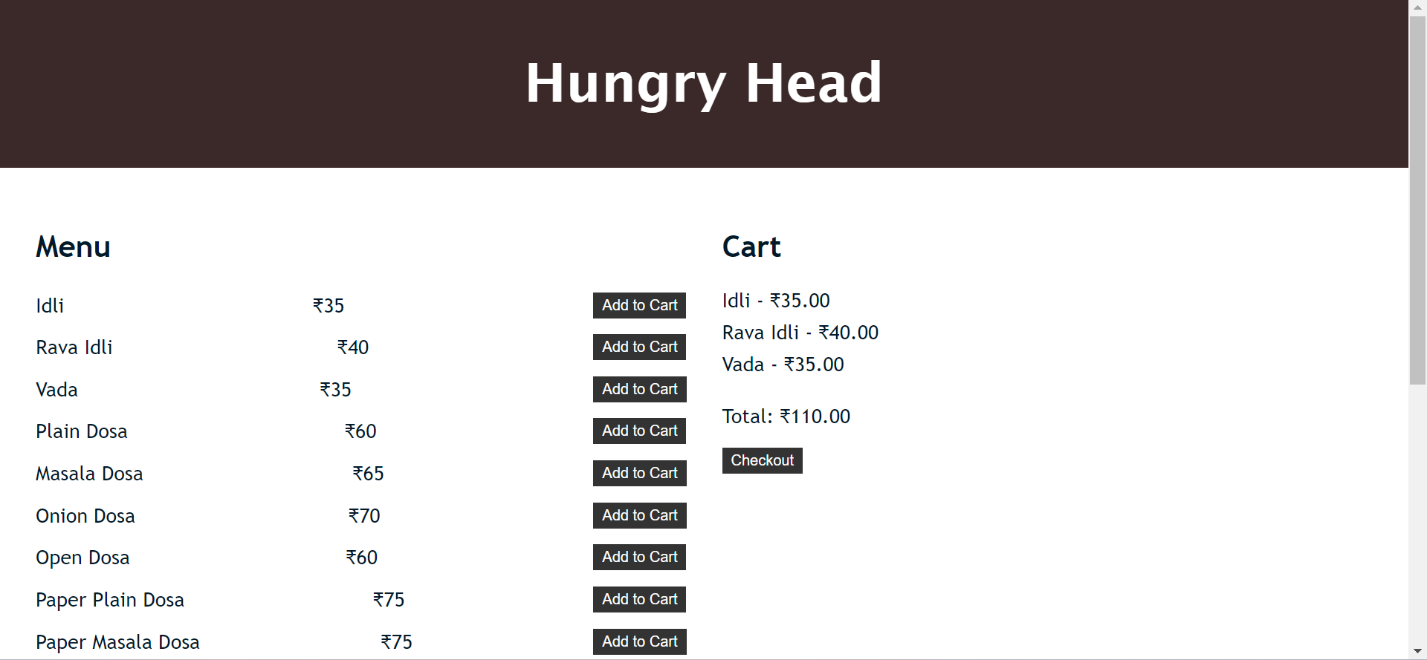
Project Screenshots

Slide 7
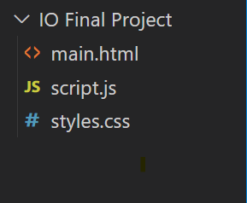
Project Structure and Effort
Our project is a simple demonstration of a restaurant menu that displays the item prices and the final bill for the customer.
Our project has an add-to-cart button to add different items to the cart.
Our project has a checkout button that gives an alert message displaying the total bill to the customer.

Slide 8
Thank You

